Slide 1




ABP Community News
Alper Ebiçoğlu
ABP Core Team Member
twitter.com/alperebicoglu
Notes:
It’s been long time since we did the last community talk. It was on last year November.

Slide 2

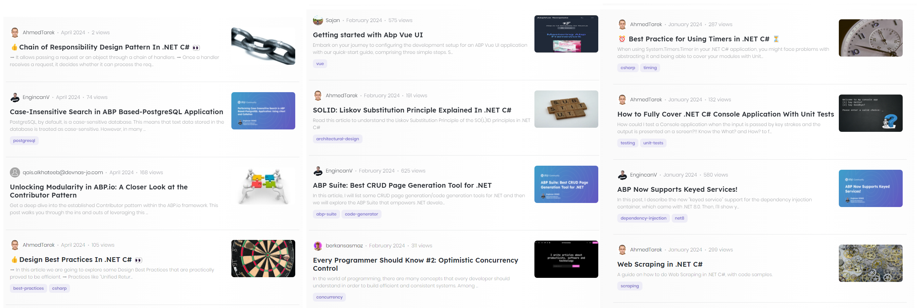
Community News
Notes:
Since the last community talk 30 new articles have been submitted

Slide 3

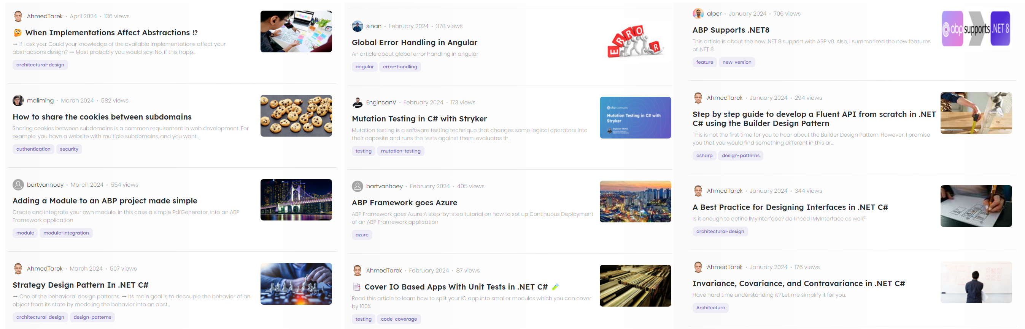
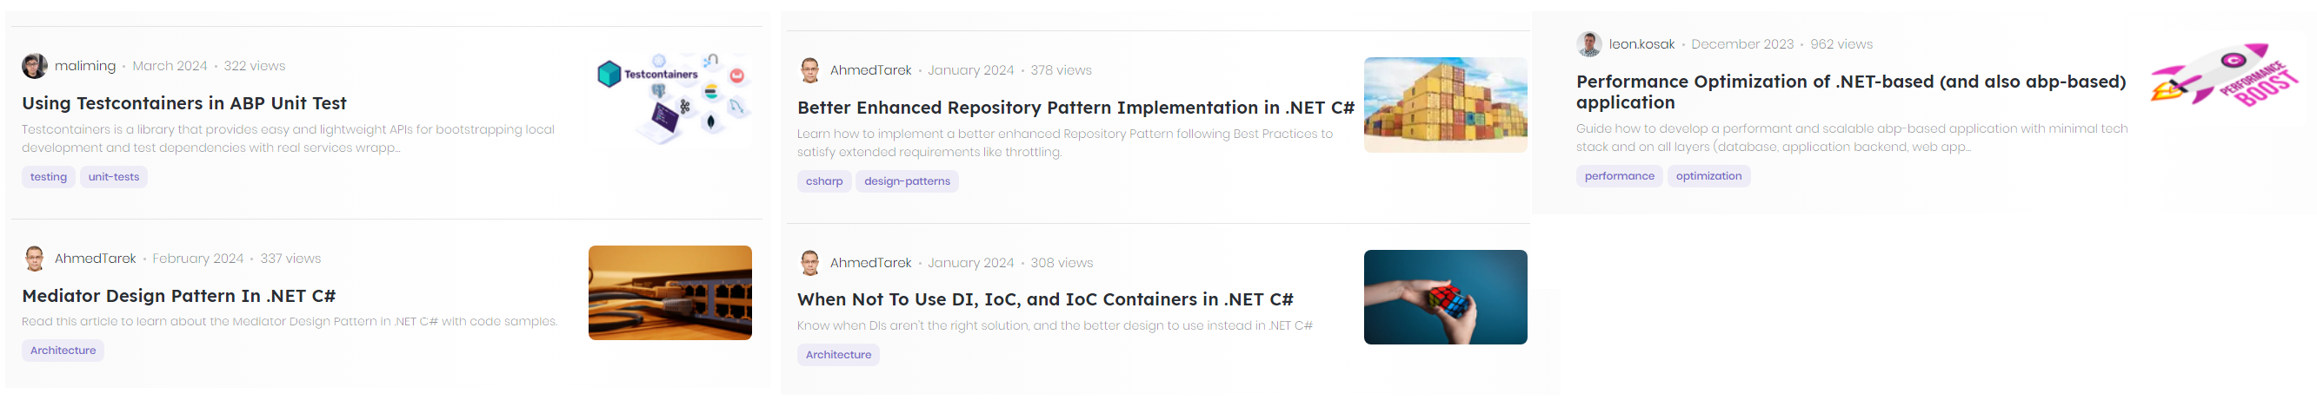
Community News

Slide 4
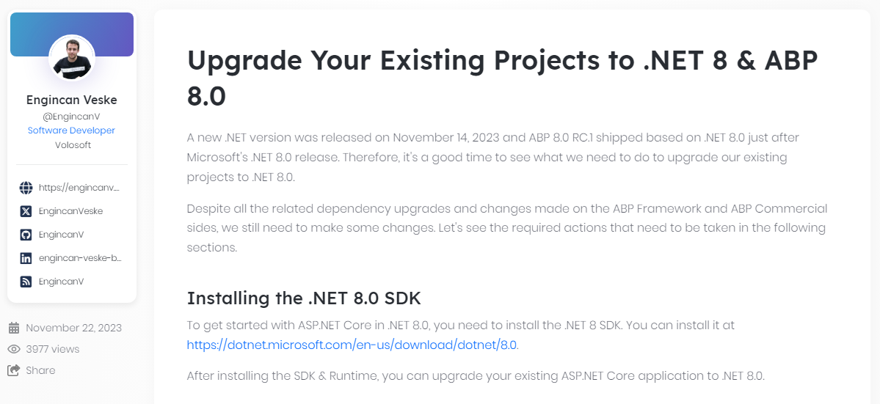
Community News
https://community.abp.io/posts/upgrade-your-existing-projects-to-.net-8-abp-8.0-x0n7hiqr
Notes:
If you have not upgraded to the latest stable .NET version, you can follow this article.

Slide 5
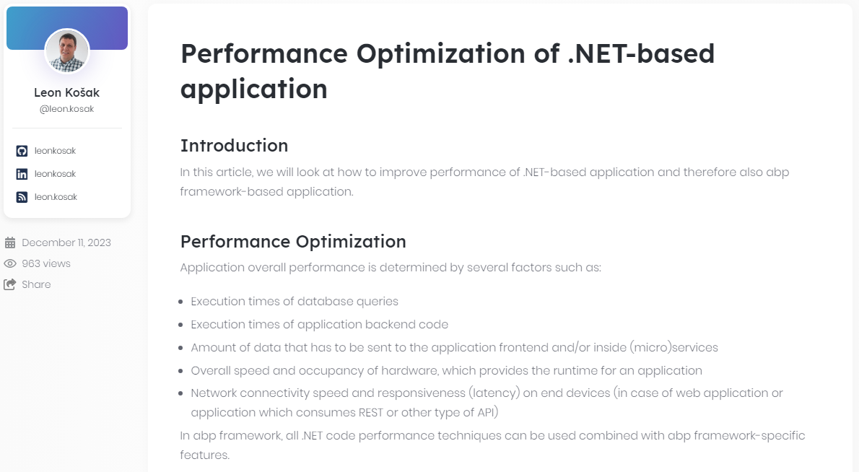
Community News
https://community.abp.io/posts/performance-optimization-of-.netbased-and-also-abpbased-application-pmdwhwxc
Notes:
Leon’s article is about a guide on how to develop a performant and scalable abp-based application with minimal tech stack.

Slide 6
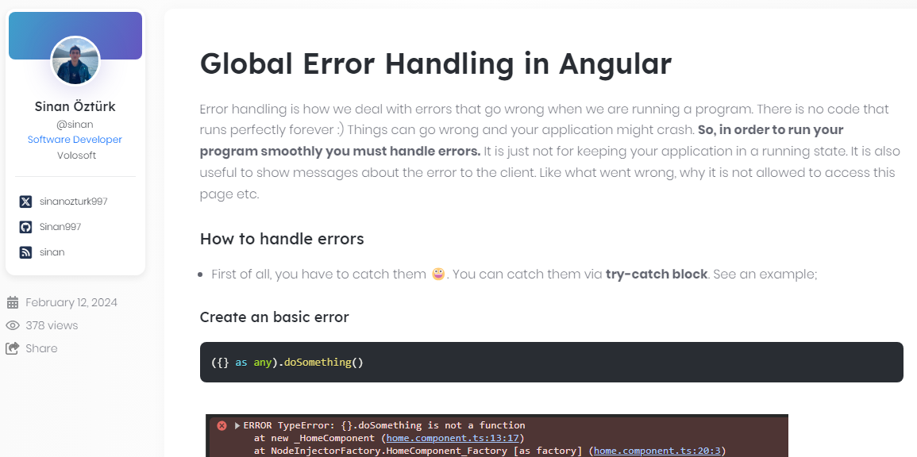
Community News
https://community.abp.io/posts/global-error-handling-in-angular-gjcb2f1e
Notes:
In this article Sinan is explaining how to make proper global error handling in Angular

Slide 7
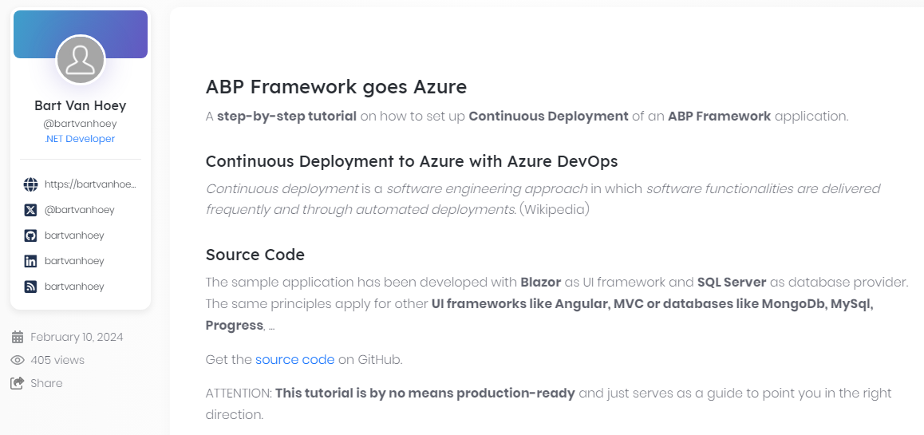
Community News
https://community.abp.io/posts/abp-framework-goes-azure-ub4u5ax5
Notes:
This is a step by step continuous deployment of an ABP project. Thanks to Bart Van Hoey.

Slide 8
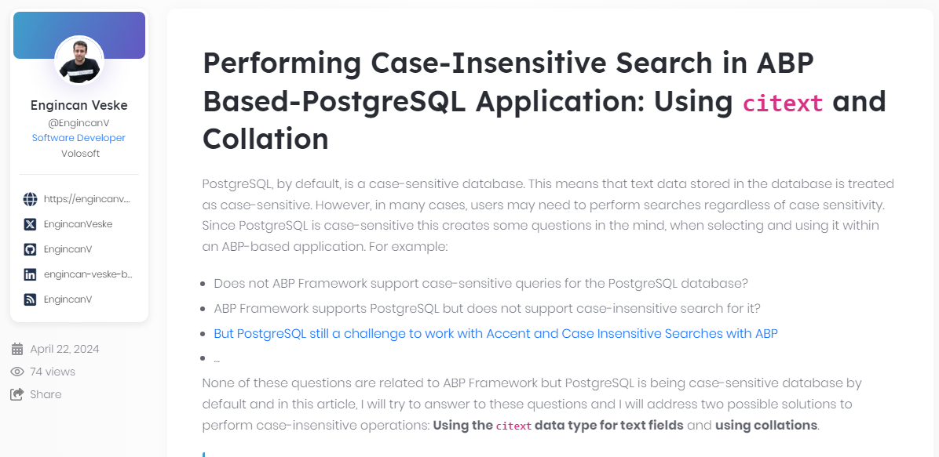
Community News
https://community.abp.io/posts/caseinsensitive-search-in-abp-basedpostgresql-application-c9kb05dc
Notes:
PostgreSQL, by default, is a case-sensitive database. This means that text data stored in the database is treated as case-sensitive.

Slide 9
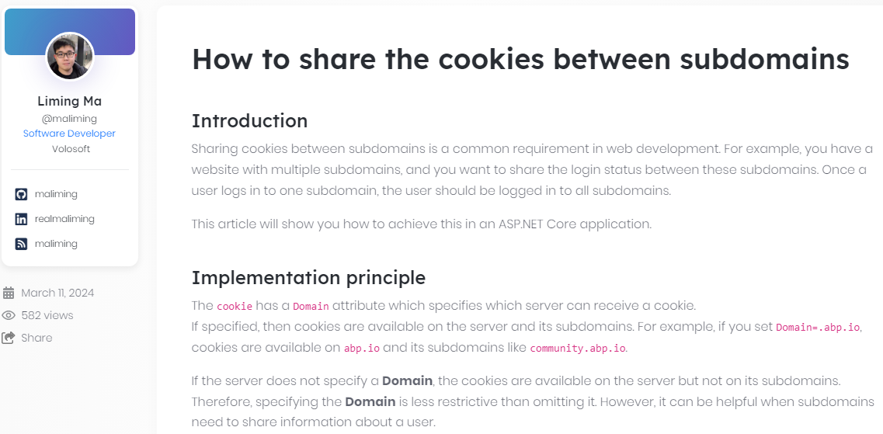
Community News
https://community.abp.io/posts/how-to-share-the-cookies-between-subdomains-jfrzggc2
Notes:
Sharing cookies among your subdomains is a must if you want to keep the logon session between your sub projects. Liming ma explains how to share cookies between subdomains.

Slide 10
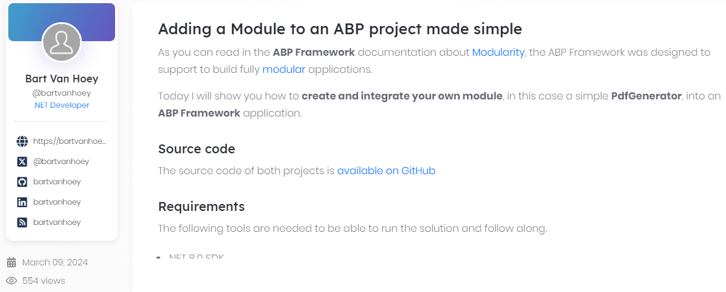
Community News
https://community.abp.io/posts/adding-a-module-to-an-abp-project-made-simple-a8zw0j2m
Notes:
ABP is a modular solution and in this article Bartt shows adding an ABP module to an ABP project.

Slide 11
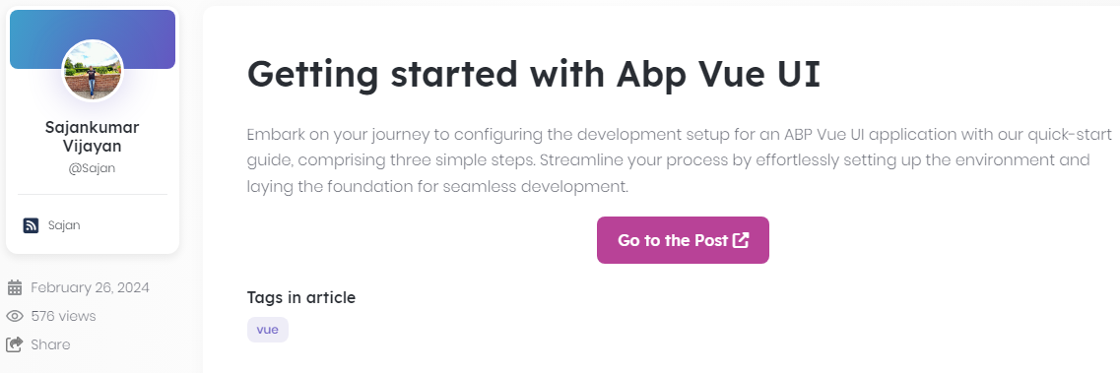
Community News
https://community.abp.io/posts/getting-started-with-abp-vue-ui-4vfiv5io
Notes:
ABP doesn’t provide a VueJS UI for now. Sajan explains how to implement a Vue frontend.

Slide 12
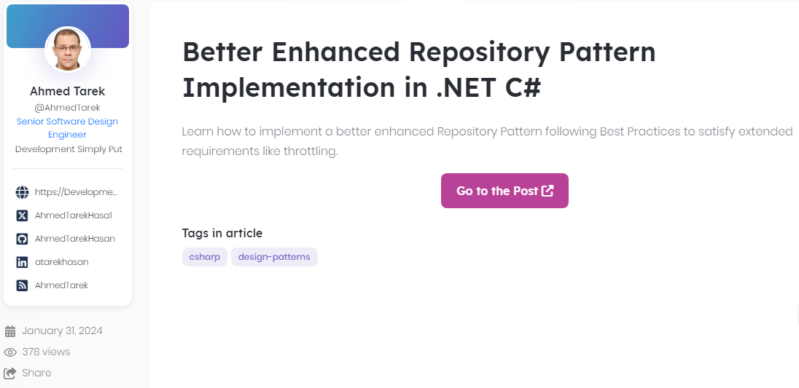
Community News
https://community.abp.io/posts/better-enhanced-repository-pattern-implementation-in-.net-c-hpkbxr3l
Notes:
Ahmed’s article is about how to implement a Repository Design Pattern following Best Practices to satisfy extended requirements like throttling.

Slide 13
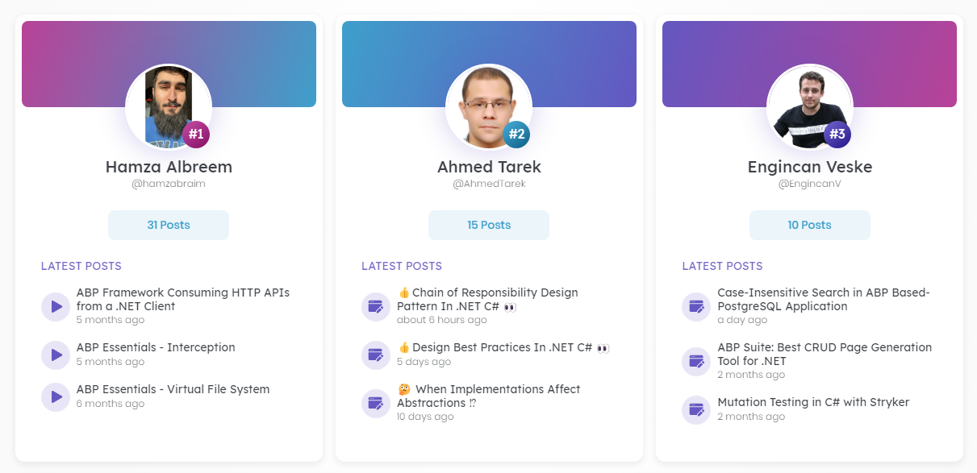
Top Contributors of ABP Community
We highlight community members who write articles and record video tutorials.
Notes:
Community.abp.io is a hub for ABP Framework, .NET and software development stuff.
You can read the articles, watch the video tutorials,
We highlight our members who contributes to the community.abp.io website by writing articles and recording video tutorials.
The last year’s top contributors are Hamza, Ahmed and Engincan.

Slide 14
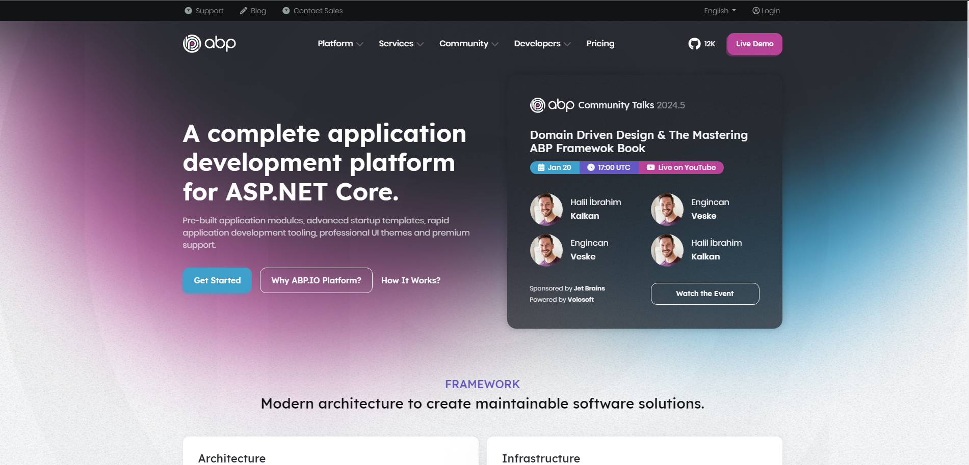
New ABP.io Platform
Read more about this process 👉 https://blog.abp.io/abp/Unifying-the-ABP-Platform
Notes:
https://blog.abp.io/abp/Unifying-the-ABP-Platform
Making content more consistent and easy to find things
Making the contents of the old subdomains more reachable,
Allow you to navigate through the web pages much easier,
Reducing duplications between different sub websites
This change will not affect the open-source ABP Framework licensing rules. ABP Framework is open-source same as before. It is only a cosmetic change.
For the commercial customers, their license plans also remain the same. Reading documentation will be much easier. Because you’ll not need to swich the docs for open-source and commercial features.

Slide 15




That’s all from the community side ☺
https://twitter.com/alperebicoglu
https://github.com/ebicoglu
https://medium.com/@alperonline

